Slide 1
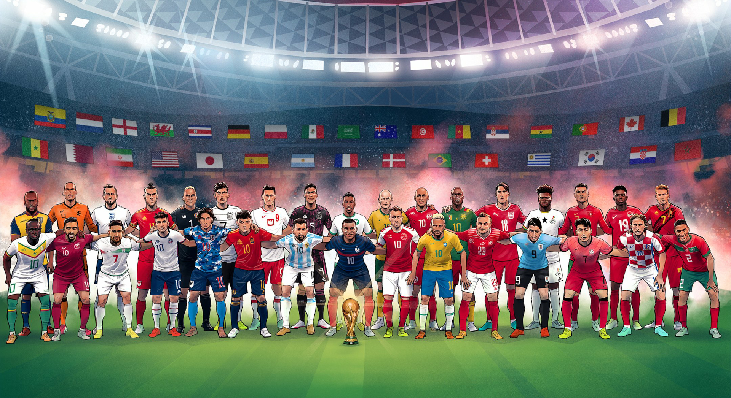
CORRELATION IS CAUSATION
(NOT)
Global Football Diversity:
Exploring the Impact of Multinational Players in World Cups

Slide 2
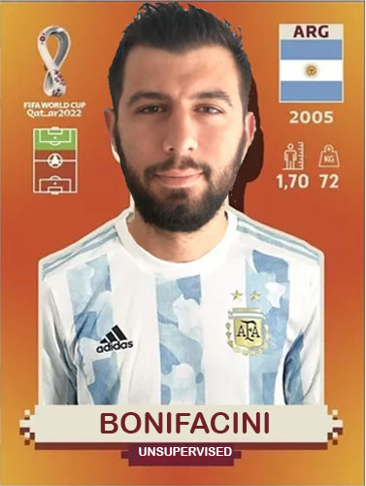
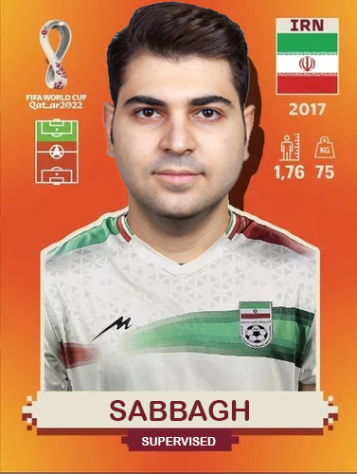

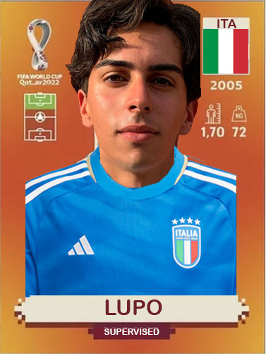
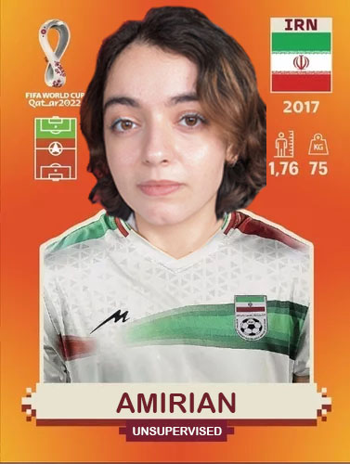
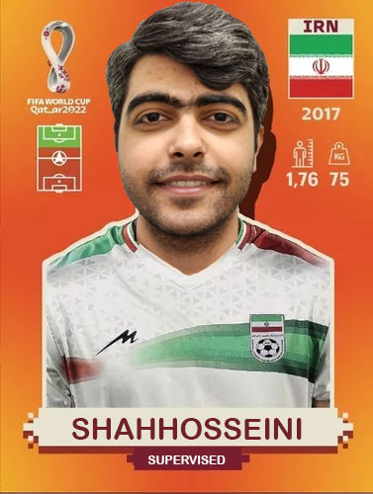
PLAYERS

Slide 3
CONTENTS
Introduction
Datasets
Exploratory Data Analysis
Unsupervised results
Supervised results
Conclusion

Slide 4

INTRODUCTION
Objective: show that the inclusion of players with nationalities different from their country of origin affects the performance of national teams in the FIFA World Cup.
Question: Does the presence of players who represent a country different from their country of origin influence the performance of national teams in the FIFA World Cup?
Methodology:
Unsupervised learning
Supervised learning

Slide 5
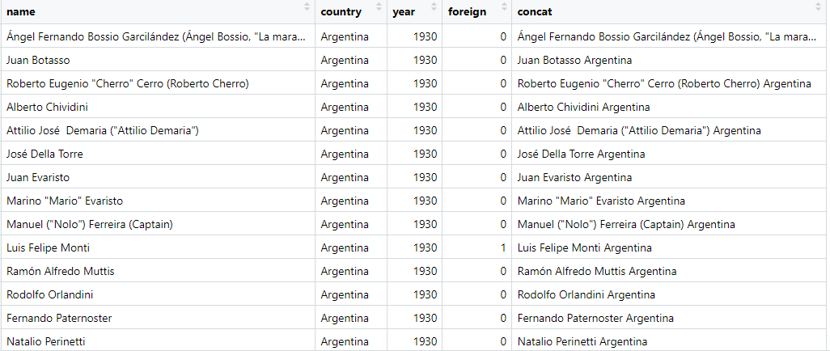
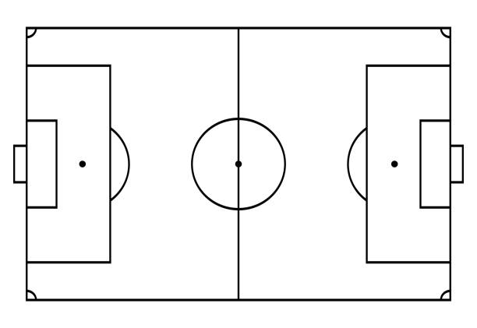

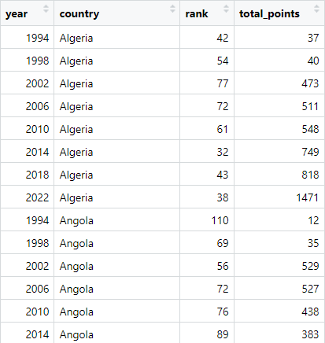
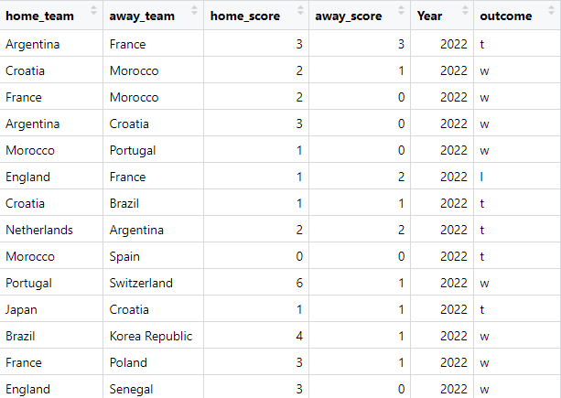

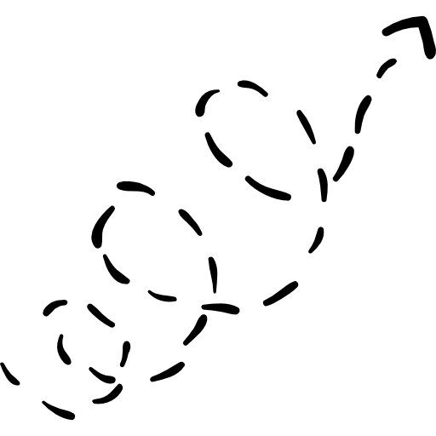

DATASETS
Rows: 10.137
Columns: 5
FINAL
DATASET
DATA
CLEANING
DATA
MANIPULATION
DATASETS
Rows: 596
Columns: 5
Rows: 964
Columns: 6

Slide 6
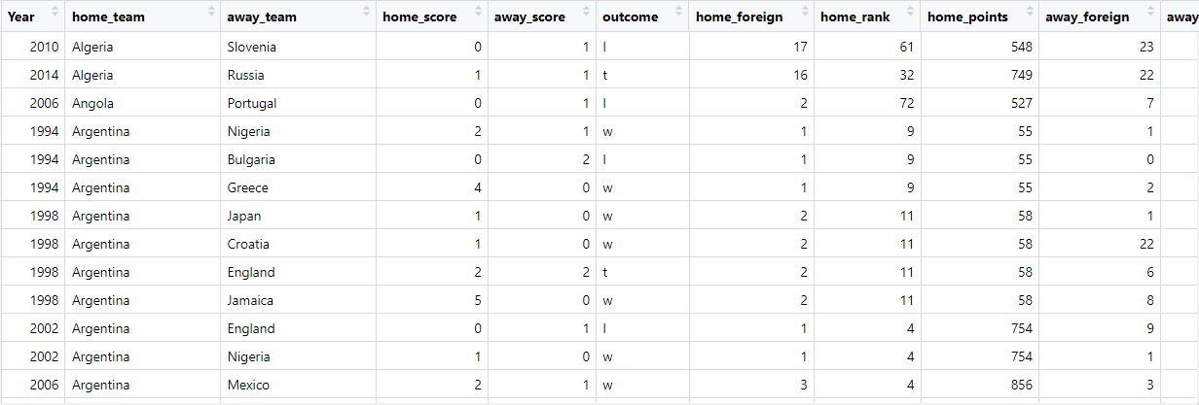
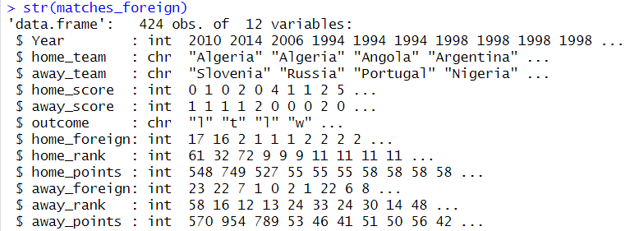
FINAL DATASET

Slide 7
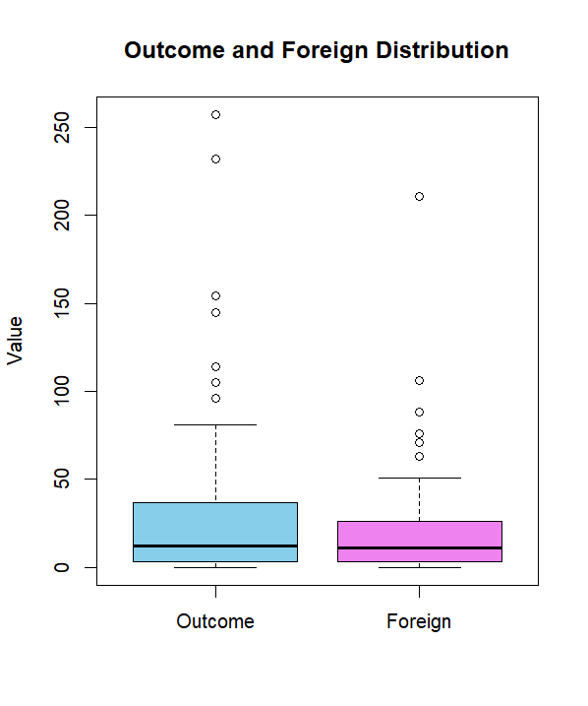
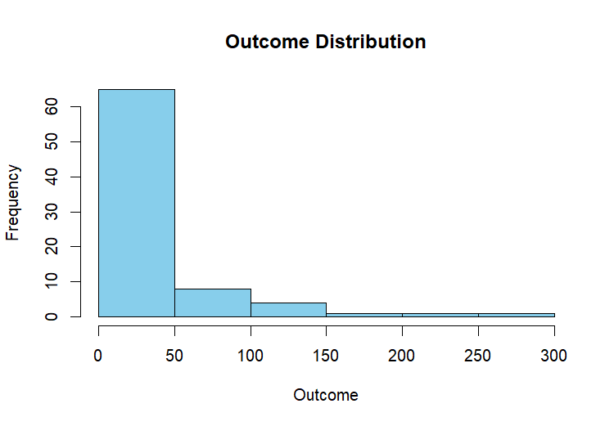
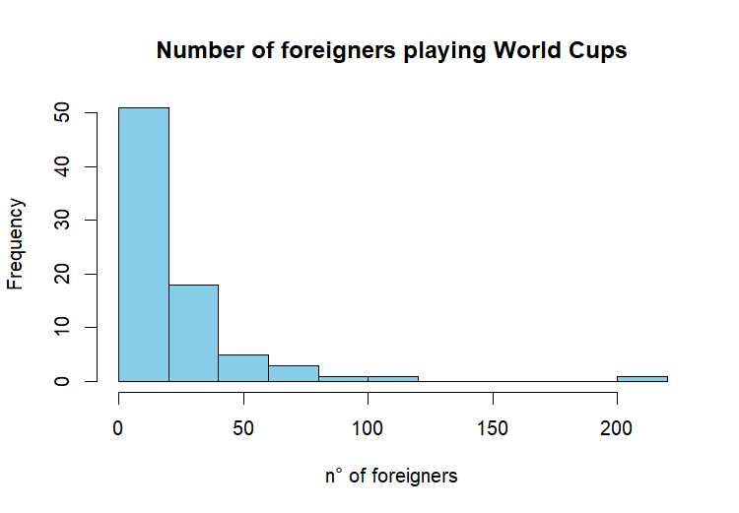
EDA - DISTRIBUTION

Slide 8
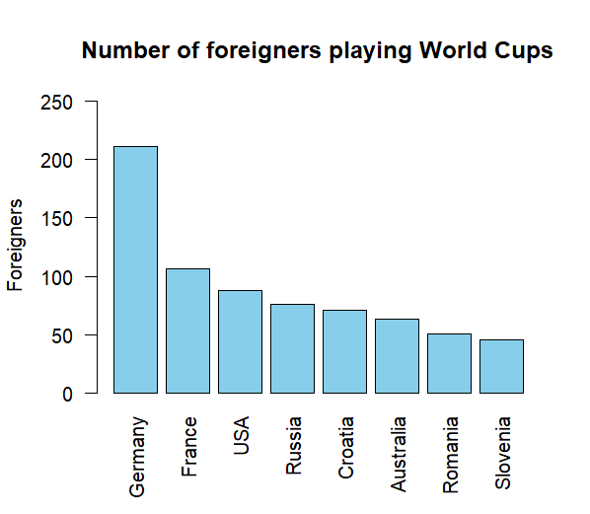
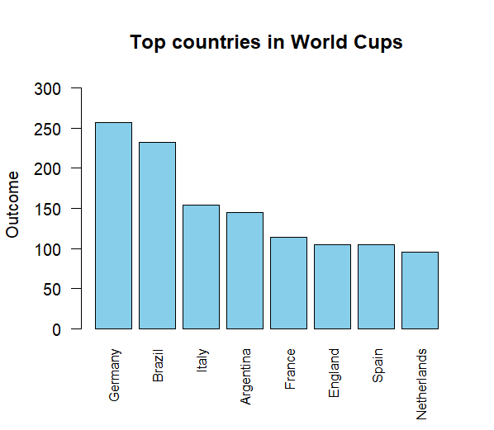
EDA – TOP 8

Slide 9
UNSUPERVISED

Slide 10
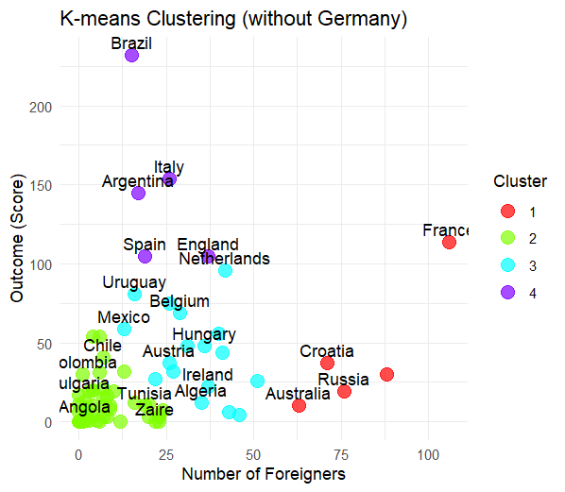
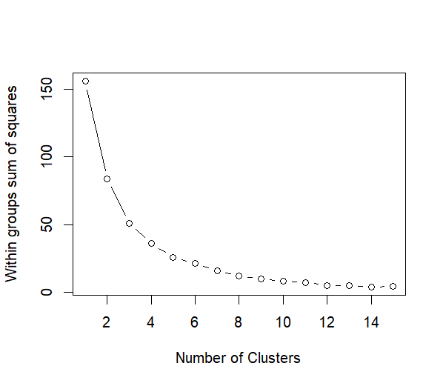
K-MEAN
K = 4
Germany is an outlier in both variables, so we excluded

Slide 11
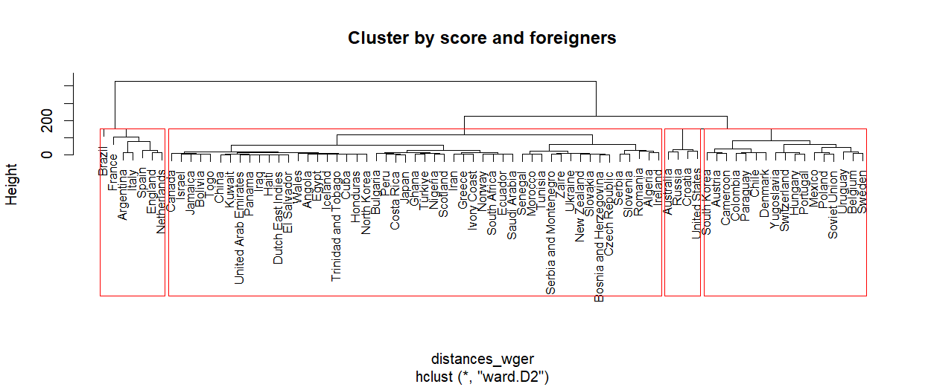
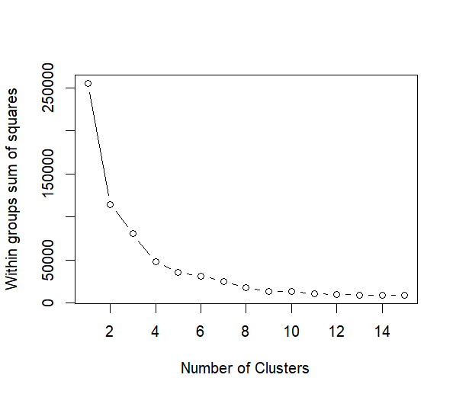
DENDOGRAM
K = 4
Germany is an outlier in both variables, so we excluded

Slide 12
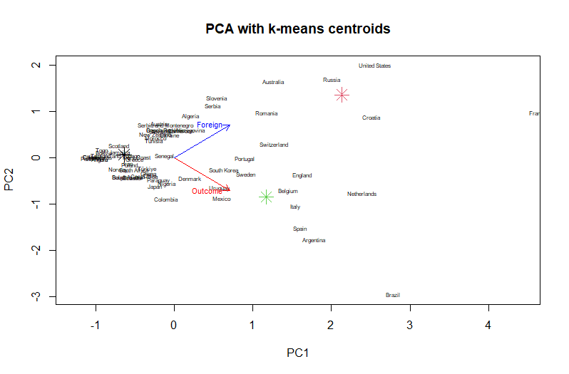
PCA

Slide 13
SUPERVISED

Slide 14
THANKS!

Slide 15
CONTENTS OF THIS TEMPLATE
Here’s what you’ll find in this Slidesgo template:
A slide structure based on a Multi-Purpose presentation, which you can easily adapt to your needs. For more info on how to edit the template, please visit our blog or read our FAQs.
An assortment of graphic resources that are suitable for use in the presentation can be found in the alternative resources slide.
A thanks slide, which you must keep so that proper credits for our design are given.
A resources slide, where you’ll find links to all the elements used in the template.
Instructions for use.
Final slides with:
The fonts and colors used in the template.
A selection of illustrations. You can also customize and animate them as you wish with the online editor. Visit Storyset to find more.
More infographic resources, whose size and color can be edited.
Sets of customizable icons of the following themes: general, business, avatar, creative process, education, help & support, medical, nature, performing arts, SEO & marketing, and teamwork.
You can delete this slide when you’re done editing the presentation.

Slide 43
THANKS!

